Slide 1

SAT & ACT Analysis
By Esther, Alexis, Rachel and Jonathon
Notes:
Agenda Slide
Slide titles/headers on each slide
Semi-technical -- some of the audience will understand data science/statistics and code
Data - walk audience through the data
Limitations of the data

Slide 2
Context
Following the change in the SAT format in March 2016, the College Board is keen to identify ways to improve SAT participation rates.
In this presentation, we examine the data provided and perform trend analysis to explore relationships between participation rates and average test scores by states.
Then we incorporate additional market analysis to look at the success of the States with high year-on-year increase, to provide recommendations on the strategy and areas to focus in improving SAT participation rate.
Notes:
Rachel
ACT has long been a widely accepted test since 2001, and since SAT’s revamp in 2016, there has been also some growth in the participation rate, though there are areas that us, College Board, can explore further
Today, My team and I gather and examine the data for 2017 and 2018 between SAT and ACT, perform trend analysis to explore relationships between participation rates and average test scores by states.
With the observation, we did some research to look at the success of the states that had higher year-on year SAT participation rates, and finally provide some recommendations and areas to improve on SAT participation rates

Slide 3
Agenda
Context
Data Import and Data Cleaning
Exploratory Analysis
Research and Findings
Conclusion and Recommendations
Notes:
Rachel
In today’s presentation, I will take you through the data we have on hand,(Alexis will cover on how we process the data, and the limitations we have, Esther will share on what kind of exploratory analysis and how we go about doing it.
Finally, based on the observation, Jon will present our findings and recommendations

Slide 4
Data Description
For the analysis, we are given the following 4 data sets (sat 2017, act 2017, sat 2018, act 2018) which includes the following data and types:
States (Object)
Participation Rate in percentage of each test by state (Object)
Average Subject & Total/Composite Scores and subtests of each test by state (Float or Int)
SAT | ACT
Math (Int) | English (Float)
Evidence-based Reading & Writing (Int) | Math (Float)
Total (Int) | Reading (Float)
 | Science (Object)
 | Composite (Float)
Notes:
Rachel - we have the 4 data sets: Sat and Act data for year 2017 and 2018 each, describing the data

Slide 5
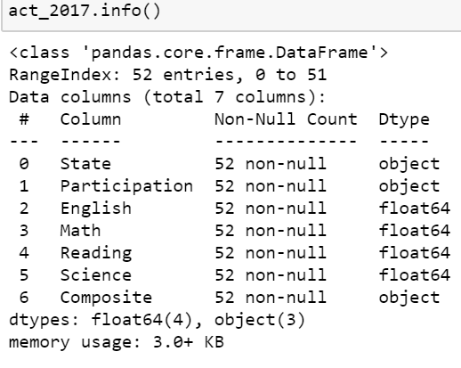
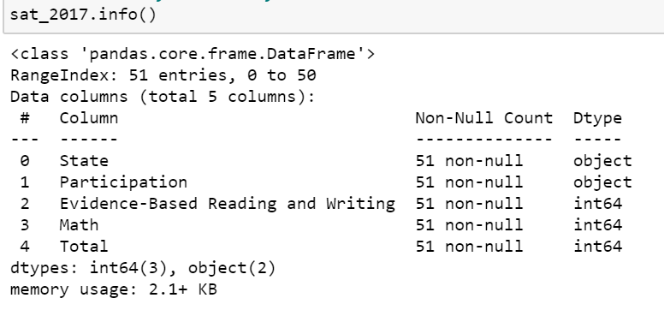
Snapshot of Data Information (2017)
Notes:
Rachel - Participation, Composite data type (Object)
51 rows - header row + 50 states
data look complete with no null values
additional data row (52 entries)

Slide 6
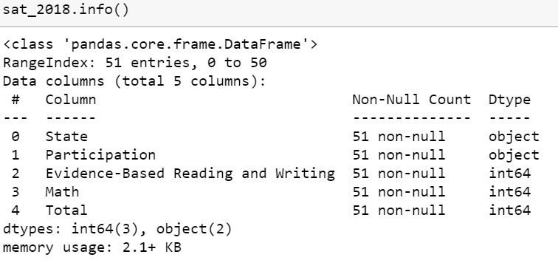
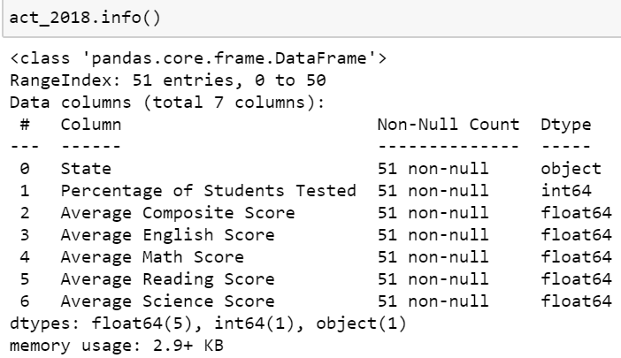
Snapshot of Data Information (2018)
Notes:
Rachel - 2018 Data looks more complete, again we look at the various data type for Participation. Next I’ll hand over to Alexis to take you through how we process our data

Slide 7
Data Processing
The following data cleaning was done before Exploratory Data Analysis:
The 2017 datasets were verified against data sources available online: SAT Data Source
ACT Data Source
Data errors identified were fixed accordingly (i.e. outliers and typo errors)
Data was converted to appropriate datatypes.
Columns were renamed for standardisation across datasets and additional rows removed.
The 2018 datasets were imported and processed similarly to the 2017 data.
The 4 datasets were merged into a final dataset for Exploratory Data Analysis and Visualisation.
Notes:
Alexis
Data errors - outlying minimum values for ACT Science score and SAT math scores, and a typo in the ACT composite score.
Datatypes - because of the % sign, the participation rates were all read as strings, making it difficult to perform statistical analyses. We performed a function across the column to remove the sign and converted the participation rates to floats.
additional rows - - row index 0 national in act 2017 csv removed
Columns were renamed to remove spaces and standardise the naming convention across datasets, and rows removed to facilitate the merging of data.
All datasets were combined into a final dataset.
Verbally explain what we changed/what error was identified
Maryland data etc, the feature we find in data

Slide 8
Data Limitations
Considering the data that we have available, there are limitations for our conclusions:
We cannot make inferences for a national population based on the state samples as the samples are not randomly drawn. We can only make analyses based on each state and describe them in relation to each other.
As we only have data for 2017 and 2018 and not for subsequent or preceding years, our trend analysis is limited to these 2 years.
With the aggregation of data by state, we only have 51 data points per dataset to work with and cannot make more granular analyses on a county or school level.
The data does not include information such as state policies which we will have to conduct outside research for.
Our conclusions and recommendations will have to take into consideration the above.
Notes:
Alexis
Before we go into the analysis, we should consider the limitations of the data that we have available, as this will necessarily influence the types of conclusions we are able to draw

Slide 9
Exploratory Data Analysis

Slide 10
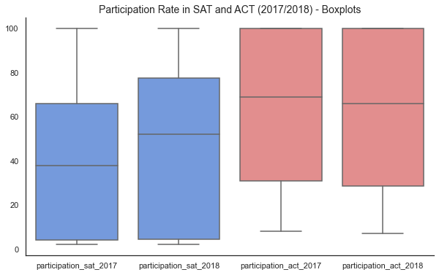
In both 2017 and 2018, the ACT had a higher median participation rate than the SAT.
Notes:
Esther

Slide 11
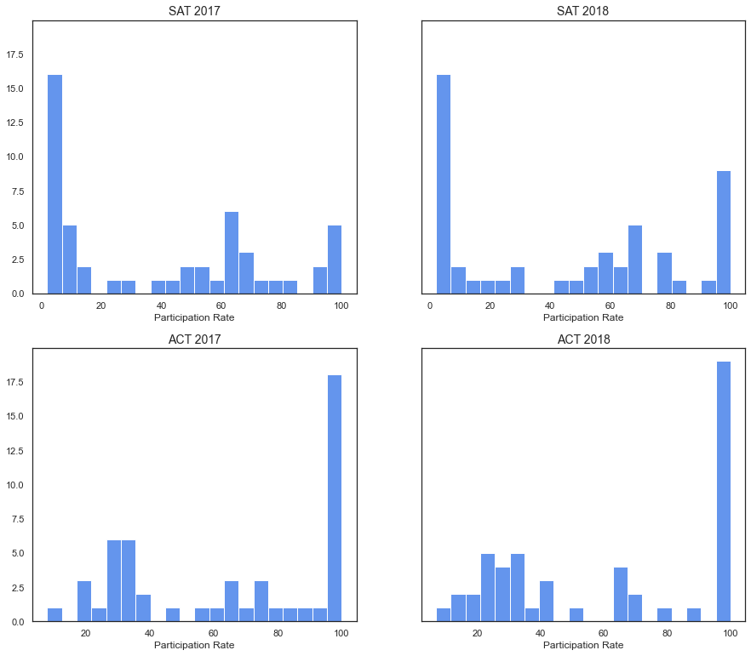
A third of the states had 100% ACT participation in 2017 and 2018. Mirroring this, a similar proportion of states have low SAT participation rate in both years.
Notably, the number of states with strong SAT participation has increased in 2018.
Notes:
Esther

Slide 12
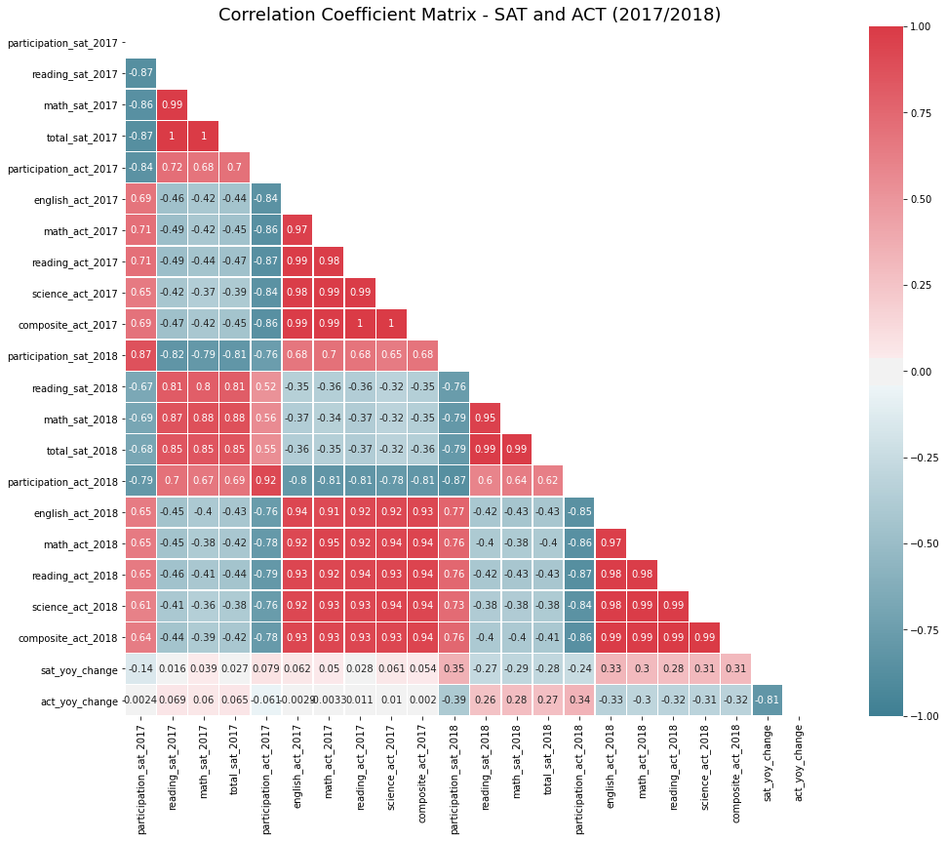
No evidence of prior year SAT test score positively correlating to SAT participation
High SAT scores in 2017 does not correlate to high SAT participation rate in 2018. In fact, negative correlation is observed.
Similarly, low ACT scores in 2017 also does not correlate to high SAT 2018 participation.
Notes:
Esther -

Slide 13
Lower participation rates are correlated with higher mean test scores.
Participation rates are strongly negatively correlated to the test’s mean scores, indicating that larger numbers of students participating pull down the average mean scores.
Participation rates for each test are also strongly negatively correlated with participation rates for the other test.
As states move toward higher participation in either test, there is a corresponding decrease in participation for the other test.
Notes:
Esther
As Esther mentioned, it is unlikely that a state’s scores in one year affects the state’s participation rate in the subsequent year. In fact, we see a strong negative relationship between a state’s participation rate and the state’s mean test scores for the respective tests - states with higher mean test scores are likely to have lower participation rates.
This is likely due to the fact that as participation rates increase, more students of different calibers are taking the test, which would pull the average scores down, versus in a state with low participation rates where only students confident of their performance may choose to take the test.
Another strong relationship we can observe from the heatmap is that participation rates are strongly negatively correlated to the participation rate for the other test, indicating that as states increase participation in one test, . As the two tests are competitors, this relationship makes sense as each state prioritizes a different tests. This is something we should keep in mind when selecting which states we would like to focus on in increasing participation rates.

Slide 14
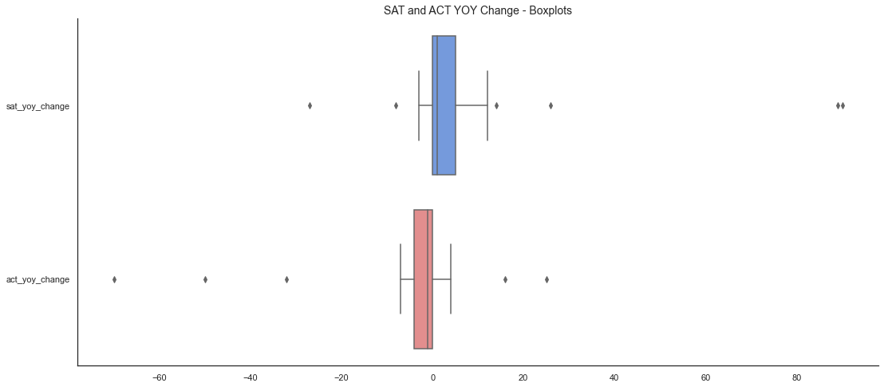
Sharp increase in SAT participation rate seen for Colorado and Illinois, along with decline in ACT participation, indicates conversion from ACT to SAT. Rhode Island also saw a notable increase in SAT participation.
Colorado
SAT yoy change: +89%
ACT yoy change: -70%
Illinois
SAT yoy change: +90%
ACT yoy change: -50%
Rhode Island
SAT yoy change: +26%
ACT yoy change: -6%
SAT yoy change
= SAT participation 2018 - SAT participation 2017
ACT yoy change
= ACT participation 2018 - ACT participation 2017
Notes:
Jon
Next, we take a look at the change in participation rates year-on-year. These metrics are calculated by subtracting the 2017 participation rate from the 2018 participation rate for both tests, to determine the percentage change. These boxplots showcase the values of the change year on year. We can see that most of the changes were quite minor, with the values concentrated around the 0 mark. However, we do see three significant outliers for positive SAT participation increase with more than 20% increase. These three states are Colorado, Illinois and Rhode Island and Illinois and Colorado also saw a corresponding decrease in ACT participation rates.
When we noticed this daJon will share more

Slide 15
State contracts and state funded test are key drivers of SAT participation rate in Colorado, Illinois and Rhode Island in 2018.
In 2017-2018, 10 states (Colorado, Connecticut, Delaware, Idaho, Illinois, Maine, Michigan, New Hampshire, Rhode Island, and West Virginia) and the District of Columbia covered the cost of the SAT for all their public school students.
Three years prior to that, only three states and the District of Columbia did so.
Sources:
https://www.edweek.org/ew/articles/2018/10/31/sat-scores-rise-as-number-of-test-takers.html
https://www.chicagotribune.com/news/ct-illinois-chooses-sat-met-20160211-story.html
https://co.chalkbeat.org/2015/12/23/21092477/goodbye-act-hello-sat-a-significant-change-for-colorado-high-schoolers
https://www.edweek.org/ew/section/multimedia/states-require-students-take-sat-or-act.html
Notes:
Jon

Slide 16
Conclusion & Recommendation

Slide 17
Conclusion & Recommendation
State contracts and state funded test are key drivers to SAT participation.
For short term, we recommended that the College Board focuses on developing partnerships with states that do not have any prevailing contract awarded to either the College Board or ACT, and currently have low SAT participation in 2018. Examples of such states include Iowa, Kansas, and South Dakota.
For a longer term, the College Board can also work on states that already mandate state-wide ACT participation and lobby the education boards to switch to the SAT when their contract with ACT is about to end, as they are more likely to have the required infrastructure and resources to support state-wide test arrangement. Examples of such states include Montana, Utah and Wyoming.
Notes:
Jon

Slide 18
Thank You

